Slide 1

Knowledge Representation
7.0 Issues in Knowledge Representation
7.1 A Brief History of AI Representational Systems
7.2 Conceptual Graphs: A Network Language
7.3 Alternatives to Explicit Representation
7.4 Agent Based and Distributed Problem Solving

Slide 2
7.0 Issues in Knowledge Representation
Knowledge representation
Core of AI
7.1 Historical retrospective
semantic networks
conceptual dependencies
scripts
frames
7.2 More modern representation
conceptual graphs
7.3 Subsumption architecture
7.4 Agents

Slide 3
7.1 A Brief History of AI Representational Schemes
Associationist(관념 연합론자) Theories of Meaning
associationist theories define the meaning of an object in terms of a network of associations with other objects
Psychological evidence
humans also organize their knowledge hierarchically
Collins and Quillian (1969)
modeled human information storage and management using a semantic network (Fig. 7.1)

Slide 4
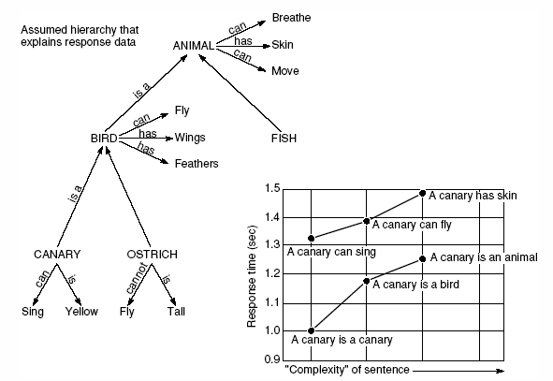
Fig 7.1 Semantic network developed by Collins and Quillian in their research on human information storage and response times (Harmon and King, 1985)

Slide 5
Semantic Network
Inheritance systems
allow us to store information at the highest level of abstraction
size reduction
consistency maintenance
Semantic network
represents knowledge as a graph (Fig. 7.2)
node: facts or concepts
arc: relations or associations between concepts
encompasses a family of graph-based representation

Slide 6
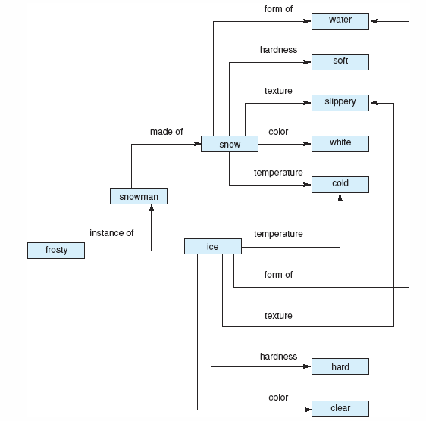
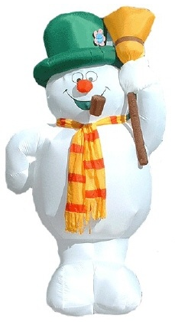
Fig 7.2 Network representation of properties of snow and ice

Slide 7
Case Frame
Case relationships include
agent, object, instrument, location, and time
a sentence is represented as a verb node, with various case links to nodes representing other participants in the action
→ case frame (Fig. 7.5)

Slide 8
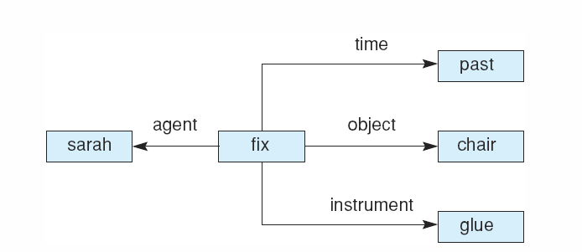
Fig 7.5 Case frame representation of the sentence “Sarah fixed the chair with glue.”

Slide 9
Conceptual Dependency
Conceptual dependency (Schank and Rieger, 1974)
the most ambitious attempt to model formally the deep semantic structure of natural language
set of four primitive conceptualizations
ACTs actions
PPs objects (picture procedures)
AAs modifiers of actions (action aiders)
PAs modifiers of objects (picture aiders)

Slide 10
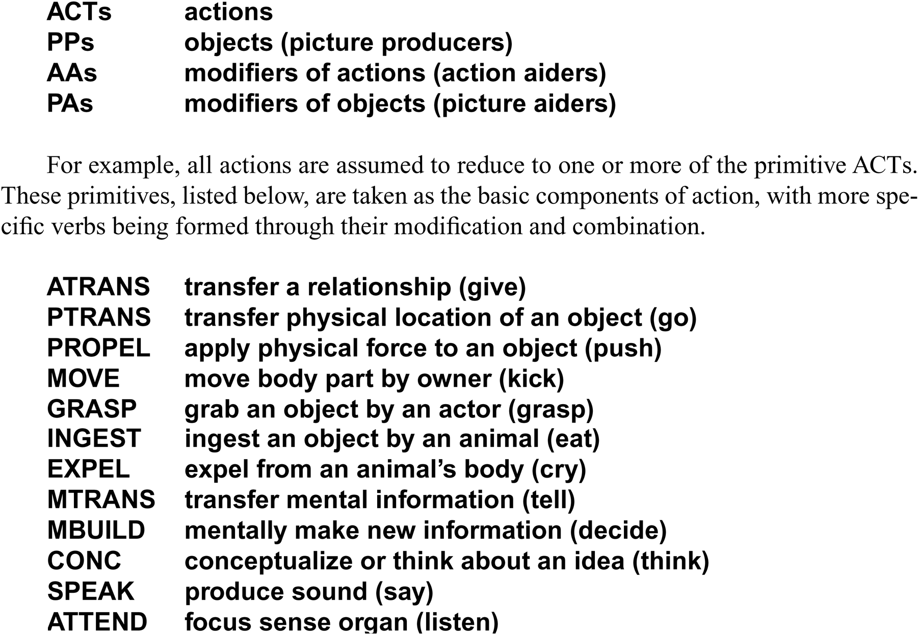
Conceptual dependency theory of four primitive conceptualizations

Slide 11
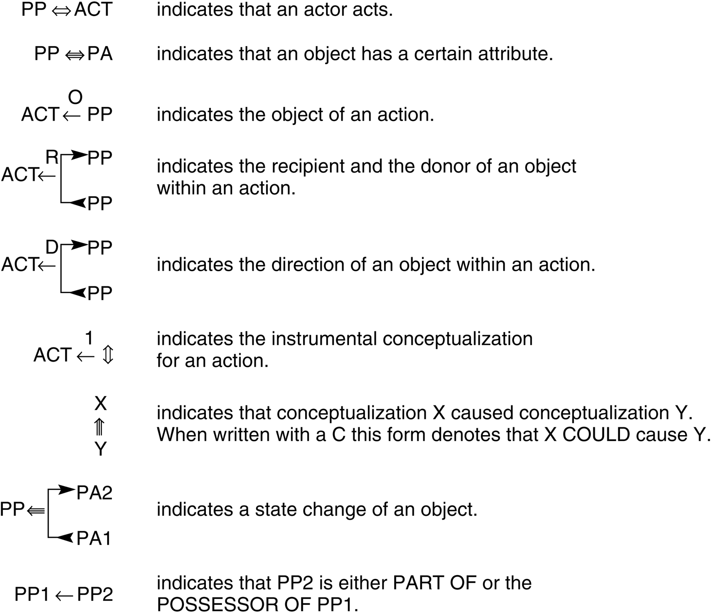
Fig 7.6 Conceptual dependencies (Schank and Rieger, 1974).

Slide 12
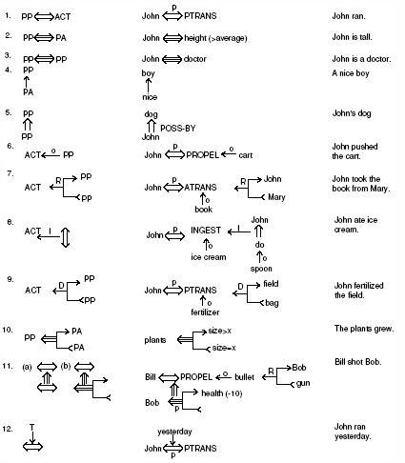
Fig 7.8 Some basic conceptual dependencies and their use in representing more complex English sentences, adapted from Schank and Colby (1973).

Slide 13
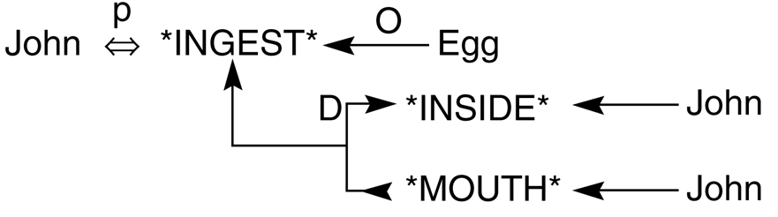
Fig 7.9 Conceptual dependency representing
“John ate the egg” (Schank and Rieger 1974).

Slide 14
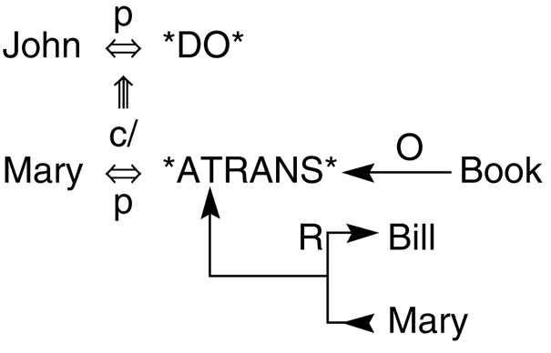
Fig 7.10 Conceptual dependency representation of the sentence
“John prevented Mary from giving a book to Bill”
(Schank and Rieger 1974).

Slide 15
Scripts
Script
structured representation describing a stereotyped sequence of events in a particular context
originally designed by Schank and Abelson (1977) as a means of organizing conceptual dependency structures into descriptions of typical situations

Slide 16
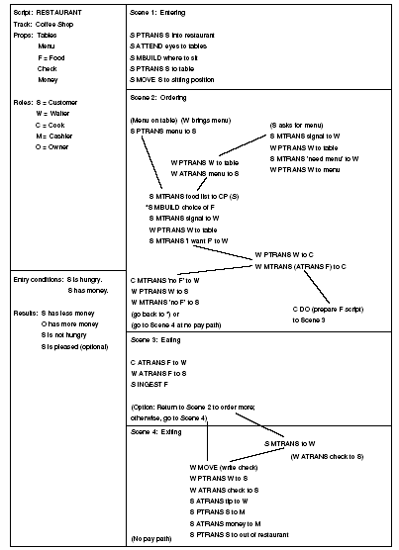
Fig 7.11 a restaurant script (Schank and Abelson, 1977).

Slide 17
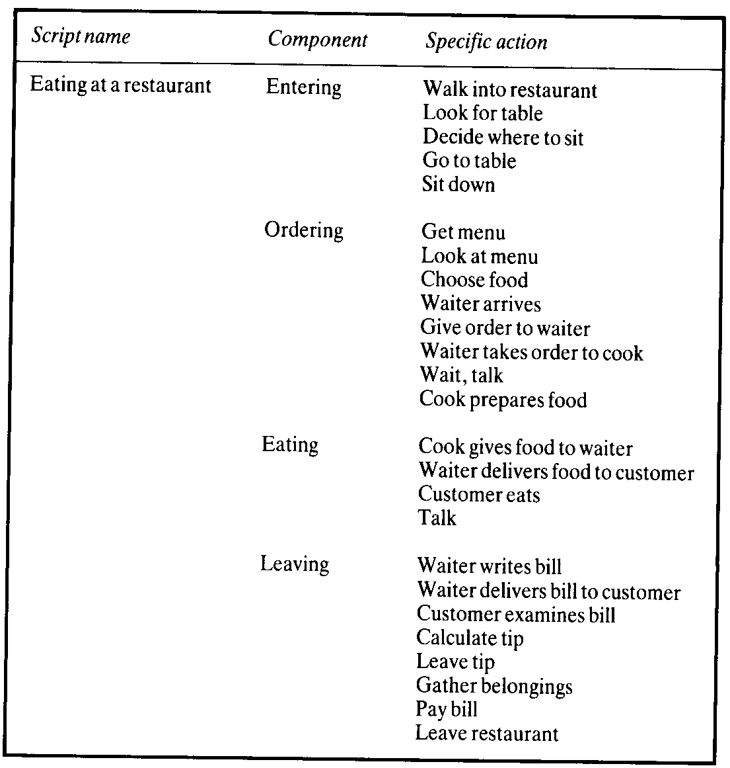

Slide 18
Frames
Frames
another representational scheme that was intended to capture in explicitly organized data structures the implicit connections of information in a problem domain
support organization of knowledge into more complex units that reflects the organization of objects in the domain

Slide 19
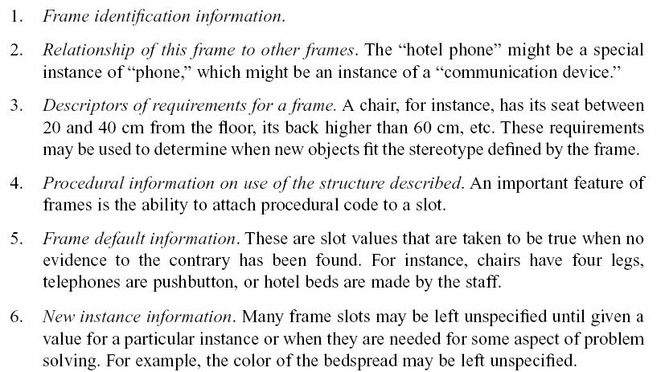
A frame includes:

Slide 20
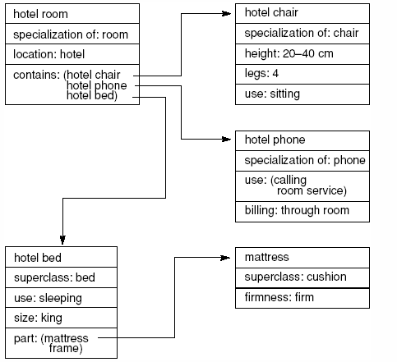
Fig 7.12 Part of a frame description of a hotel room. “Specialization”
indicates a pointer to a superclass.

Slide 21
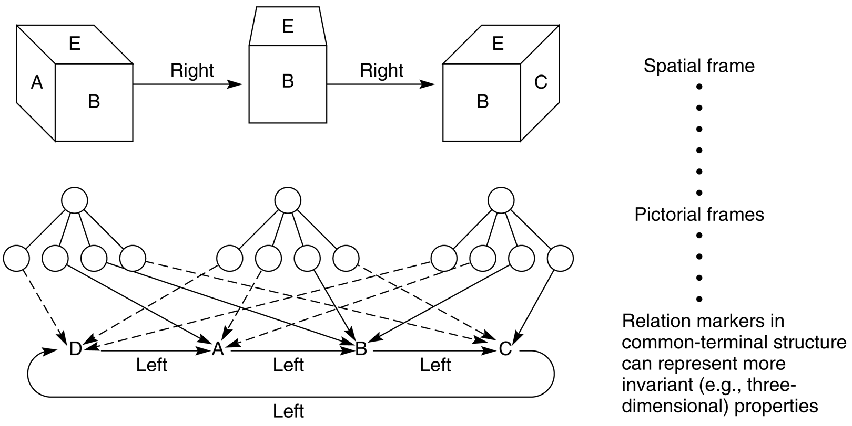
Fig 7.13 Spatial frame for viewing a cube (Minsky, 1975).

Slide 22
Frames (cont’d)
Frames
extend semantic networks in a number of important ways
make it easier to organize our knowledge hierarchically
procedural attachment to create demons
class inheritance
natural way to represent stereotypic entities, classes, inheritance, and default values
➔ object-oriented programming design philosophy

Slide 23
7.2 Conceptual Graphs: a Network Language
Conceptual graph by Sowa (1984)
example of network representation language
finite, connected, bipartite graph
node: concepts(boxes) or conceptual relations(ellipses)
no labeled arcs
concept only have arcs to relations, and vice versa

Slide 24
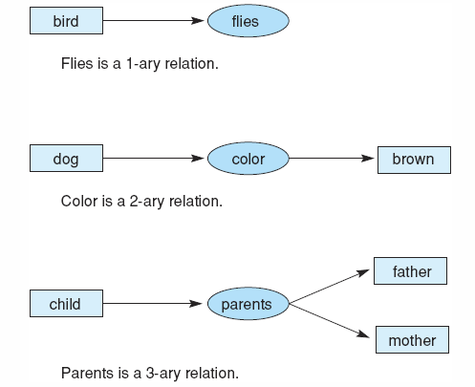
Fig 7.14 Conceptual relations of different arities.

Slide 25
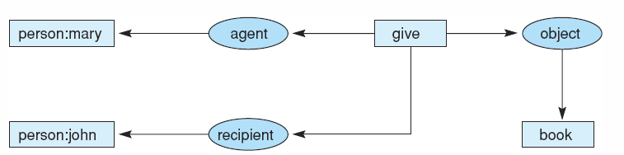
Fig 7.15 Graph of “Mary gave John the book.”

Slide 26
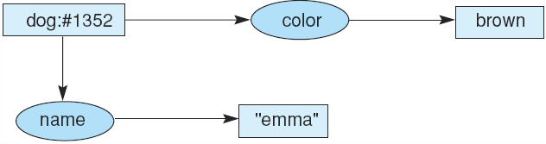
Fig 7.16 Conceptual graph indicating that the dog named Emma is brown.
Fig 7.17 Conceptual graph indicating that a particular (but unnamed) dog is brown.
Fig 7.18 Conceptual graph indicating that a dog named Emma is brown.

Slide 27
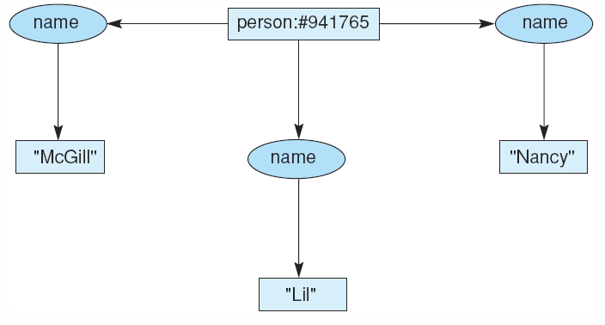
Fig 7.19 Conceptual graph of a person with three names.

Slide 28
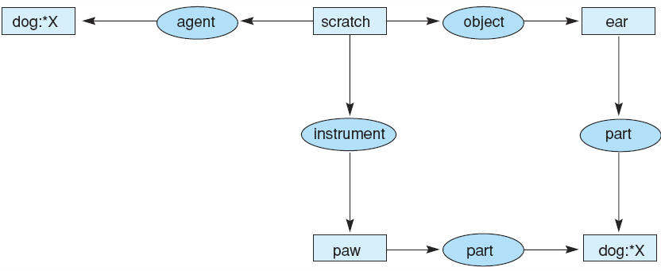
Fig 7.20 Conceptual graph of the sentence “The dog scratches its ear with its paw.”

Slide 29
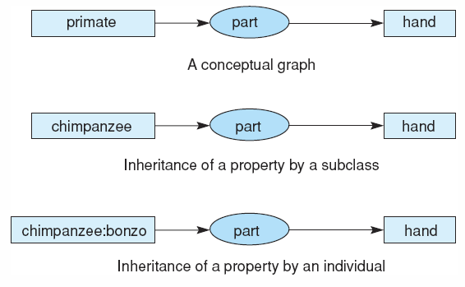
Fig 7.23 Inheritance in conceptual graphs.

Slide 30
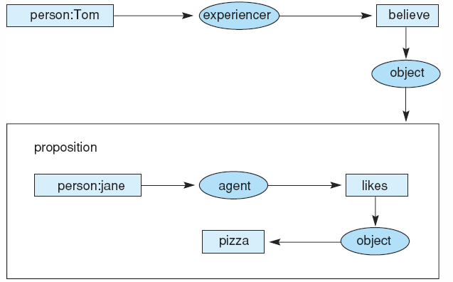
Fig 7.24 Conceptual graph of the statement “Tom believes that Jane likes pizza,” showing the use of a propositional concept.

Slide 31
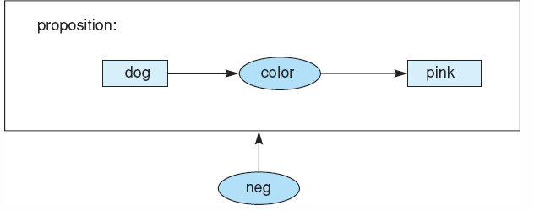
Fig 7.25 Conceptual graph of the proposition “There are no pink dogs.”

Slide 32
7.3 Alternatives to Explicit Representation
Brooks’ Hypothesis and the Subsumption(포섭) Architecture
intelligence is the product of the interaction between an appropriately layered system and its environment
Fig. 7.26: subset of functions of three-layered architecture that supported an early robot

Slide 33
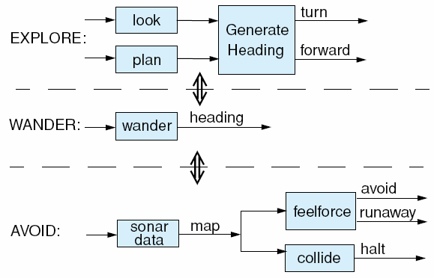
Fig 7.26 The functions of the three-layered subsumption architecture from Brooks (1991a). The layers are described by the AVOID, WANDER, and EXPLORE behaviours.

Slide 34
The Copycat Architecture (Fig. 7.27)
copycat is a problem-solving architecture built by Melanie Mitchell (1993)
a model of analogy making and human cognition based on the concept of the parallel terraced scan
“abc is to abd as ijk is to what?” (abc:abd :: ijk:?)
copycat builds on many of the representational techniques that preceded it, including blackboards, semantic networks, connectionist networks, classifier systems
copycat requires a global “state” to be part of the problem solver
different from Brooks’ approach

Slide 35
The 3 major components of Copycat architecture
workspace
a global structure, similar to blackboard systems
slipnet
a network composed of nodes, which represent permanent concepts, and weighted links, which are relations, between them (Fig. 7.28)
coderack
builds structures in the working area and modify activations in the slipnet accordingly (bottom-up processes)
Those are mediated in their interactions by a temperature measure
degree of randomness used in making decisions

Slide 36
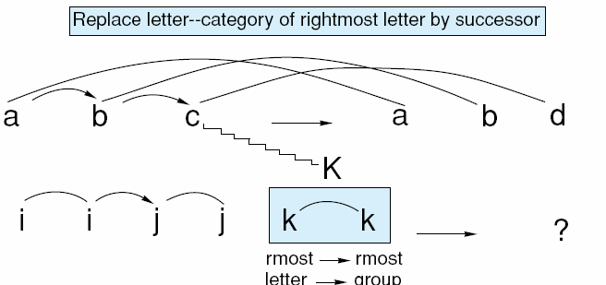
Fig 7.27 A possible state of the copycat workspace. Several examples of bonds and links between the letters are shown; adapted from Mitchell (1993).

Slide 37
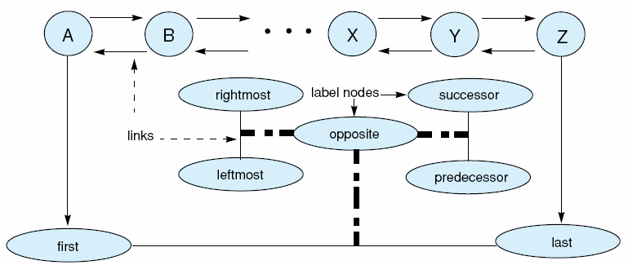
Fig 7.28 A small part of copycat’s slipnet with nodes, links, and label nodes shown; adapted from Mitchell (1993).

Slide 38
7.4 Agent-Based and Distributed Problem Solving
Two insights in the AI research community in the 1980s
DAI(Distributed Artificial Intelligence) community
discussion of issues related to intelligent problem solving with systems consisting of multiple problem solvers (at MIT, 1980)
Rodney Brooks and his group at MIT (1980s)
intelligent problem solving does not require a centralized store of knowledge manipulated by some general-purpose inferencing scheme ➔ notion of distributed and cooperative models of intelligence
intelligence is situated and active in the context of particular tasks ➔ allows the problem solver to offload aspects of the solution process into the environment itself

Slide 39
Agent-Oriented Problem Solving: A Definition
Multi-agent system
a computer program with problem solvers situated in interactive environments, which are capable of flexible, autonomous, yet socially organized actions that can be, but need not be, indirected towards predetermined objectives or goals
four criteria for an intelligent agent system
situated, autonomous, flexible, and social

Slide 40
Examples of and Challenges to an Agent-Oriented Paradigm
Manufacturing
Automated Control
Telecommunications
Transportation Systems
Information Management
E-Commerse
Interactive Games and Theater

